Slide 1



RESEARCH PRESENTATION
EnterpriseSynth: Agentic SFT + Eval Data from API Schemas Without Live Execution
OPENAPI SCHEMA
VERIFIED TRACE
OFFLINE
VERIFIED
Schema-aware agentic framework · Proof of concept and viability
Notes:
Introduce EnterpriseSynth as a proof-of-concept for generating verified agent training and evaluation data directly from API schemas.

Slide 2


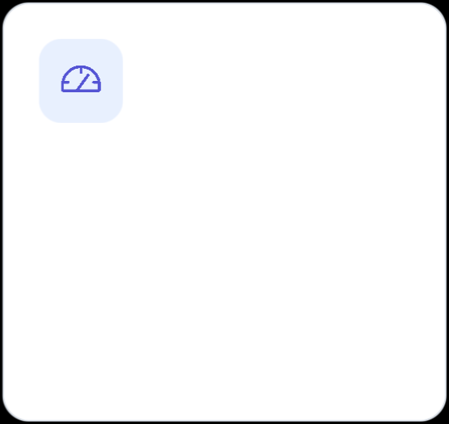
The execution bottleneck
Traditional data generation assumes APIs can be called safely and repeatedly.
Sandbox limits
Privacy risk
Rate constraints
Enterprise APIs may be unavailable, costly, or impossible to execute in isolated environments.
Live traces can expose credentials, sensitive data, and operational behavior.
Infrastructure quotas and rate limits make large-scale trajectory collection brittle.
CORE QUESTION
Can the specification itself become the data source?
Notes:
Frame live API execution as the adoption bottleneck: sandbox access, privacy exposure, and infrastructure constraints.

Slide 3



Useful agent behavior can be synthesized from structure—not execution.
INPUT
PROCESS
OUTPUT
OpenAPI specification
Schema-aware synthesis
Verified traces
Zero API keys · Zero calls · Deterministic schema checks
Notes:
State the research question: can schema-aware synthesis produce useful tool-use data without executing APIs?

Slide 4

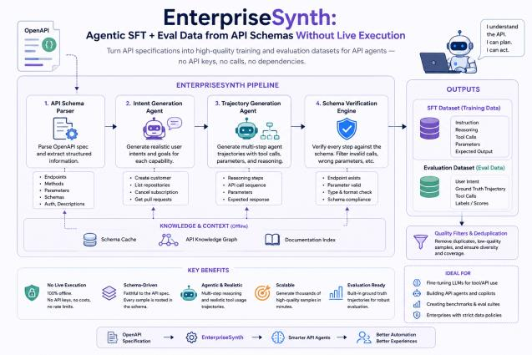
EnterpriseSynth at a glance
SYSTEM OVERVIEW
Four stages convert an API schema into SFT and evaluation datasets.
Notes:
Walk through the full EnterpriseSynth architecture shown in the paper figure.

Slide 5


A four-stage synthesis pipeline
Each stage narrows the space of possible agent behavior.
01
02
03
04
API schema parsing
Intent synthesis
Trajectory generation
Schema verification
Extract endpoints, methods, parameters, schemas, and authentication descriptions.
Generate realistic user intents and goals for each API capability.
Create multi-turn tool-use traces with calls, parameters, and reasoning.
Reject invalid traces with deterministic structural checks.
SPECIFICATION → INTENT → TRAJECTORY → VERIFIED DATA
Notes:
Explain the four stages from schema parsing through deterministic verification.

Slide 6

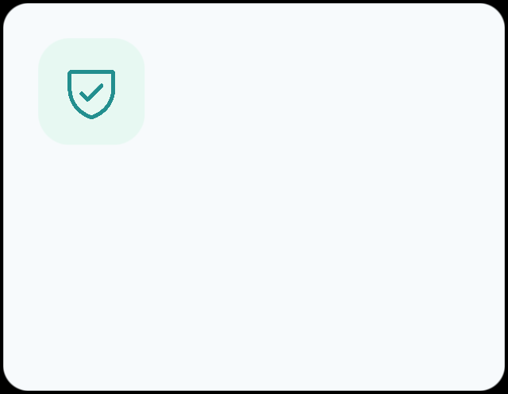
Verification by construction
Every generated step is checked against the source schema.
DETERMINISTIC CHECKS
Endpoint and method exist
Required parameters are present
Invalid traces never enter the dataset.
Types and formats match
Verification becomes a data-quality gate.
Trajectory structure is complete
No live API response is required for validation.
SAFE · REPEATABLE · AUDITABLE
Notes:
Emphasize deterministic schema verification and why it matters for reliable offline data generation.

Slide 7


Evaluation design
A compact downstream test of whether synthesized traces transfer.
HELD-OUT DOMAIN
MODEL
TRAINING SET
Zoom
Qwen2.5-0.5B
45
Compare the untuned base model with a model fine-tuned on EnterpriseSynth data.
LoRA fine-tuning measures whether a small model learns valid tool-use behavior.
examples
Three training epochs in the reported experiment.
Tool selection accuracy
Parameter validity
Training loss
Notes:
Describe the held-out Zoom API evaluation and the small LoRA fine-tuning proof-of-concept.

Slide 8


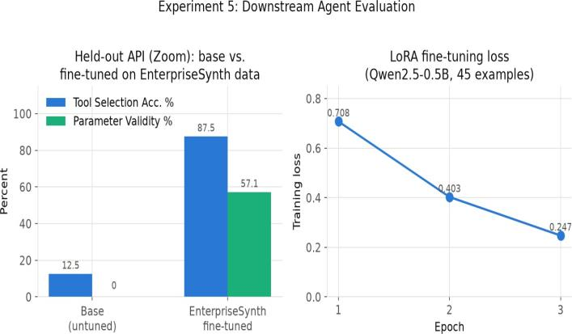


Downstream agent evaluation
12.5 → 87.5%
Tool selection accuracy
0 → 57.1%
Parameter validity
.708 → .247
Training loss, epoch 1→3
A small fine-tuning set produces a large improvement on a held-out API.
Notes:
Highlight gains in tool selection and parameter validity, plus the falling training loss across three epochs.

Slide 9





What the results establish
Evidence of viability
Current limits
SFT traces can be generated without live API calls.
45-example fine-tuning set
Schema checks provide a deterministic quality filter.
Single held-out API: Zoom
Fine-tuning improves held-out tool-use behavior.
Single reported model: Qwen2.5-0.5B
The experiment is a proof of concept—not yet a claim of broad generalization.
Notes:
Separate what the proof-of-concept establishes from the limitations of the current experiment.

Slide 10
Thank you
EnterpriseSynth · Research presentation
Notes:
Thank the audience, restate the central proof-of-concept, and invite questions and discussion.

